Slide 1
Design for Verification Project Update
2021-04-05
Eldrick Millares, Jack Humphries (eldrick, jhumphri@stanford.edu)

Slide 2
Recap:
Ongoing Deployment on Steel (simple design)
Planning Deployment on BOOM (complex design)
Developing SQED Debug Utilities

Slide 3
Steel Demo - Current Status (1/2)
Nearly finished
Fixed handling of pipeline flushes + commit logic
Remaining bug centers on Constraint C2 not working properly
(QED consistent when symbolic, in-flight instructions commit)
Likely an error in my current understanding of the assertion / tool
Anyone that I should turn to for help with Questa tools?

Slide 4
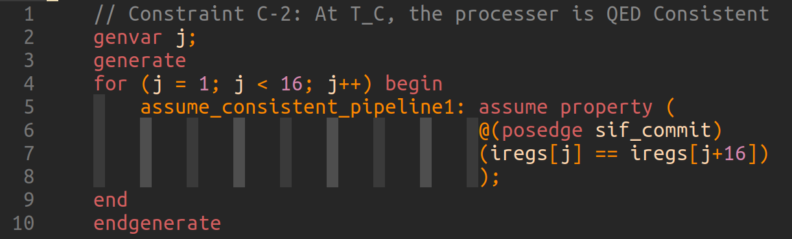
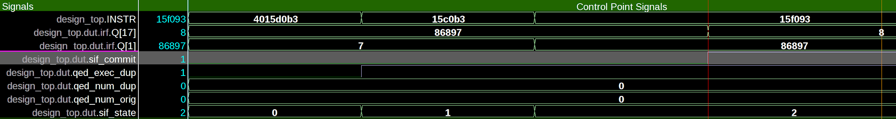
Steel Demo - Constraint C2 Issue

Slide 5
Steel Demo - Current Status (2/2)
Finding Good Debugging Flow
Enabling / Disabling Instructions gives fine granular control over areas of design you are exercising
Want to extend to all of RV32I to get interesting cases since design is simple
Missing Instructions from all demos so far:
Load Immediates: LUI, AUIPC
Jumps: JAL, JALR
Conditional Branches: BEQ, BNE, BLT[U], BGE[U]
Environment Calls and Breakpoints: ECALL, EBREAK
May require extension / rework of the SQED Generator
Status of CFTSS-V and CFCSS-V with SQED (+ Symbolic Starting States)?

Slide 6
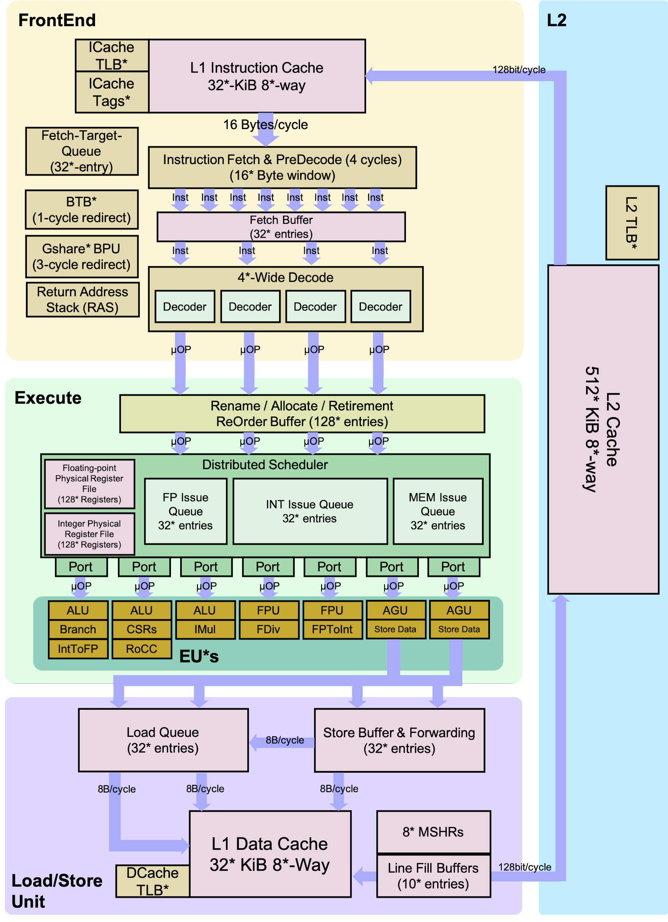
BOOM Demo - Current Status
Chipyard tutorial later this week to generate BOOM
Will be working with another student in lab group to deploy to the core
BOOM should yield many interesting test cases
Targeting the generated verilog (Chisel -> FIRRTL -> Verilog)

Slide 7
SQED Utilities - Current Status
Added RV32 Hex -> Assembly Tool
Lightweight debugging of instruction traces
Python, easy to extend and incorporate in other workflows
Working on automatic export from bug trace waveform -> readable instructions
Planning to build instruction-trace -> constraint tool
Input list of instructions to run
Good for reproducible demos

Slide 8
Next Steps Summary
Extend scope of ISA and finish Steel deployment
Generate BOOM core, identify required signals, start deployment

